Slide 1
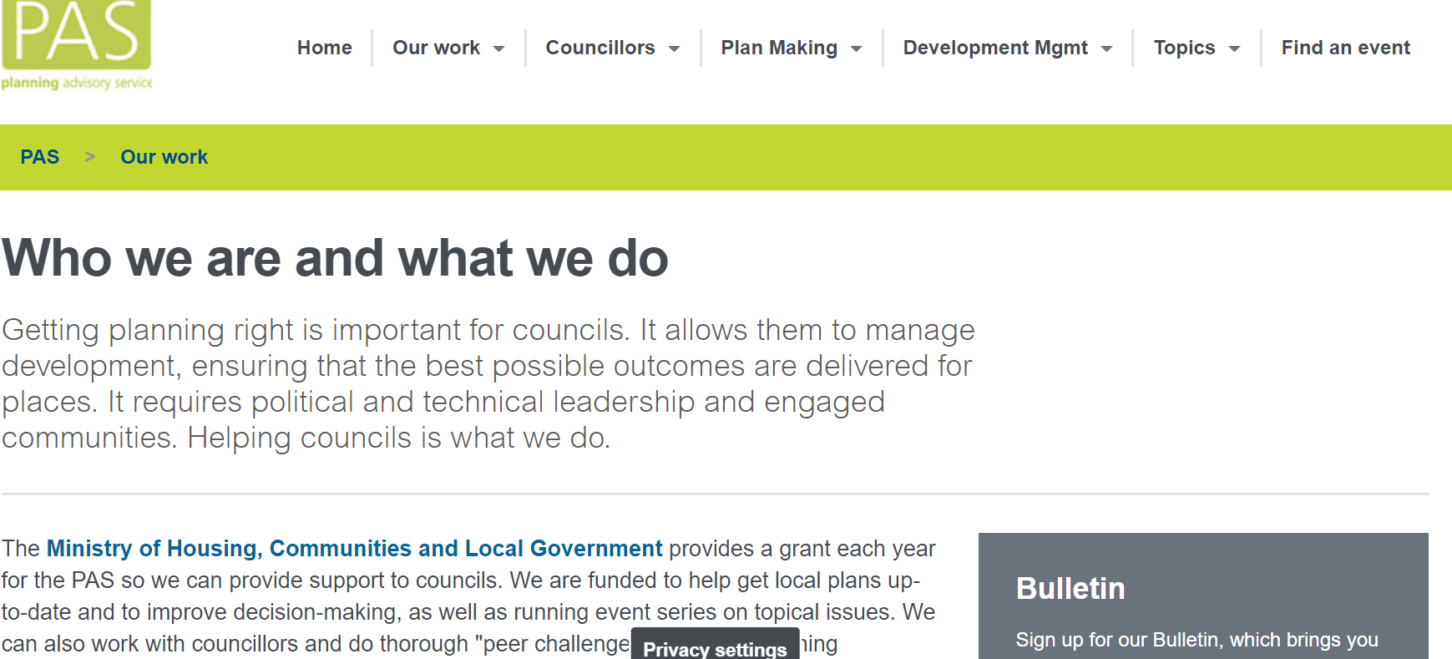
Planning Advisory Service (PAS)
Team of 9
Provide support to councils
Funded to help get local plans up-to-date and improve decision-making
Run event series on topical issues
Offer support through peer reviews
Who’s here today?
Notes:
Poll (Zoom): have you worked with PAS before?

Slide 2
LPA Biodiversity Net Gain Capacity and Skills Project
Two year project funded by Defra started in March 2021
Focus on BNG, but also touching on LNRS and other relevant aspects of Environment Bill
Aim is to enable LPAs to be ‘day one ready’ for BNG
Develop a programme of training and support for 330+ LPAs England-wide:
Policy planners
Development management planners
Councillors
Outputs will include:
Community of LPA planners and members
Website and resources focused to key groups

Slide 3
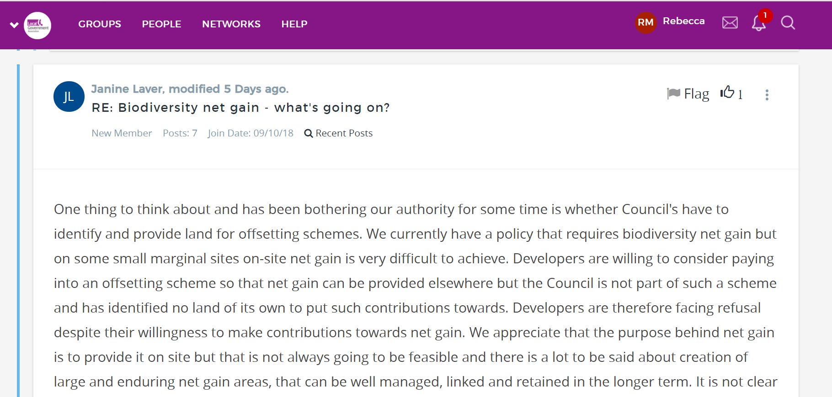
What have we done so far
Information sharing - NE and Defra
Project, evaluation and communications plans
Website: https://www.local.gov.uk/pas/topics/environment
Knowledge Hub discussion
Workshops for LPAs

Slide 4
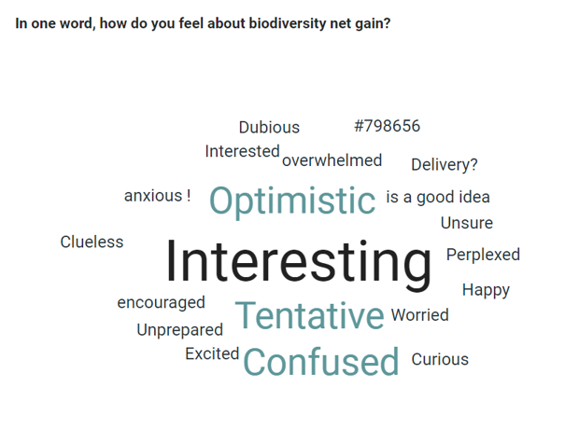
LPA workshops
>200 registered from >150 LPAs
Introduction | Environment Bill and biodiversity net gain
Discussion session 1 | How ready are you for mandatory biodiversity net gain?
Discussion session 2 | How do you think we should focus our support?
Summing up, next steps and feedback
Finish at 4pm

Slide 5
LPA workshops
Biodiversity Net Gain is currently encouraged in national planning policy, ahead of becoming mandatory through the provisions of the Environment Bill. Is your Authority currently involved in the delivery of any BNG in your authority area?
Yes – 49%
No – 51%

Slide 6
But the LPA journey can look very different …..
Place-making principles
Local Plans
BNG policies w/ local distinctiveness
Development Management
Validating checklist for BNG
Some standard BNG conditions
Delivery
Assessment of sites for BNG
Third party local offsite delivery
An evidence base
Detailed guidance (SPD)
The agreed metric
A template for S106 agreements on BNG
LA managed habitat banks
National statutory credit system
Monitoring – onsite and offsite
An agreed target
Assessing BNG in applications
Strategy for offsite BNG delivery (LNRS)
Now
Mandatory BNG
Notes:
BNG market poll in Zoom

Slide 7
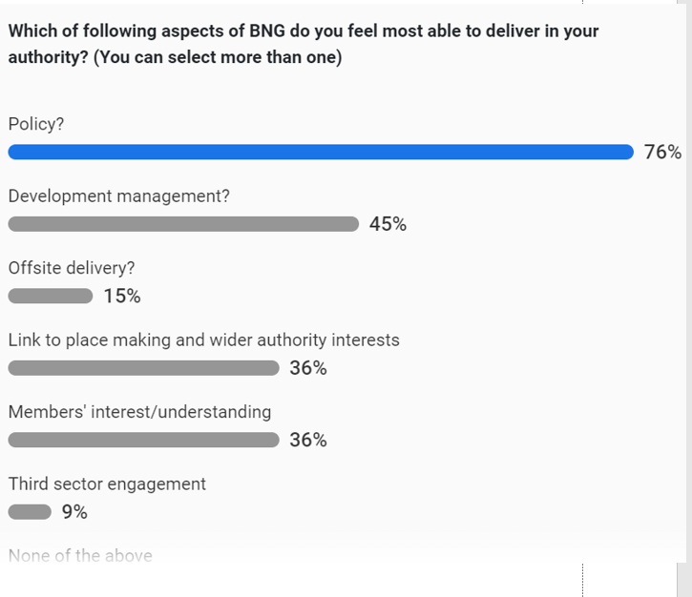
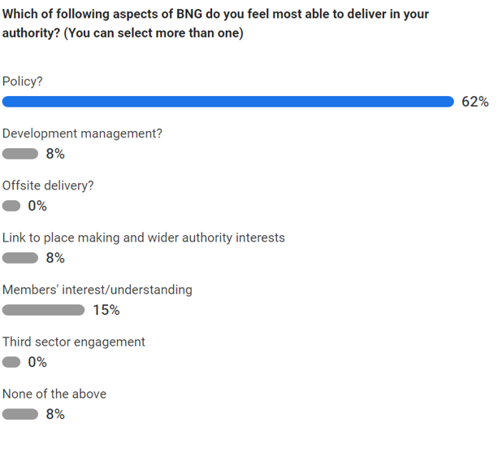
LPA workshops

Slide 8
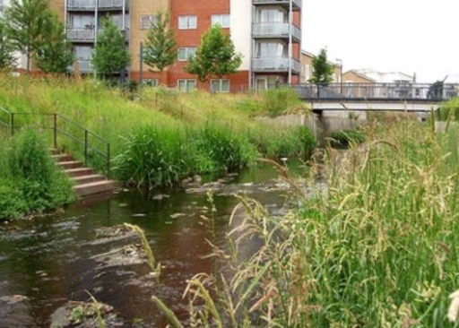
LPA workshops
Key issues raised:
Viability
Resourcing and expertise
What evidence is needed for local plans
Monitoring

Slide 9
What’s next & how can you get involved?
Councillor workshop 16 June
Draft base offers
Set up LPA advisory group
Workshop for London Boroughs 15 July
Case studies/examples
Who’s engaging?
Who’s struggling?

